Slide 1
Deep learning and Bioinformatics, Part 1
School of International Engineering and Science
Hilal Tayara
Assistant Professor

Slide 2
Contents
Bioinformatics
Introduction
Data resources
Research topics
AI for bioinformatics
What is AI?
Why AI for bioinformatics?
Deep learning
Deep learning workflow

Slide 3
Bioinformatics
Bioinformatics is an interdisciplinary field that develops methods and software tools for understanding biological data, in particular when the data sets are large and complex.
As an interdisciplinary field of science, bioinformatics combines biology, computer science, information engineering, mathematics and statistics to analyze and interpret the biological data.
Bioinformatics has been used for in silico analyses of biological queries using mathematical and statistical techniques.

Slide 4
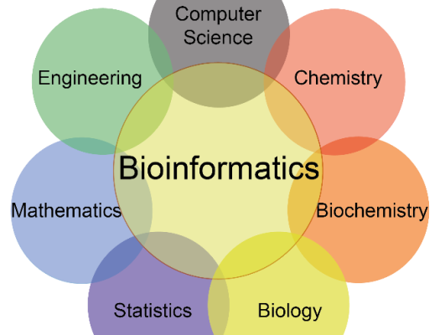
Bioinformatics

Slide 5
Bioinformatics
Biology
Data
Model
Algorithm
What is the biological question or problem?
why do we need this method
– What is the input data? – What other supportive data can be used?
– How is the biological problem is formulated computationally?
– What is the computational algorithm?
– How about its performance/limitation?

Slide 6

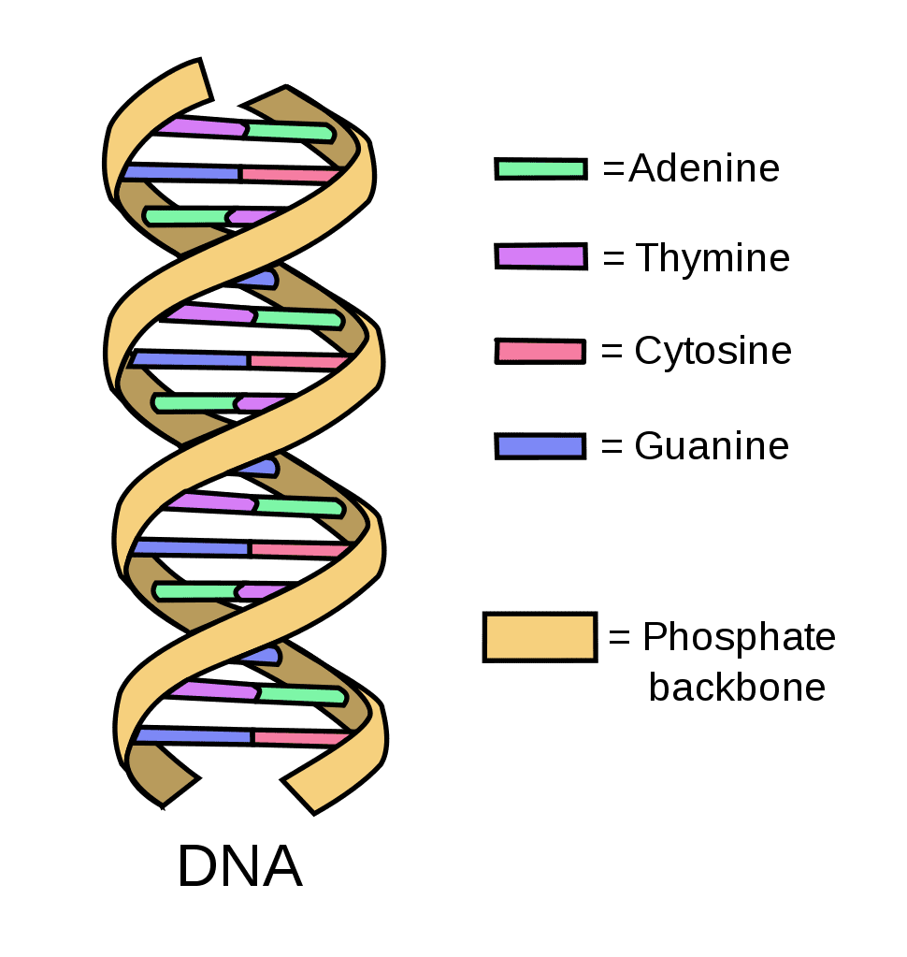
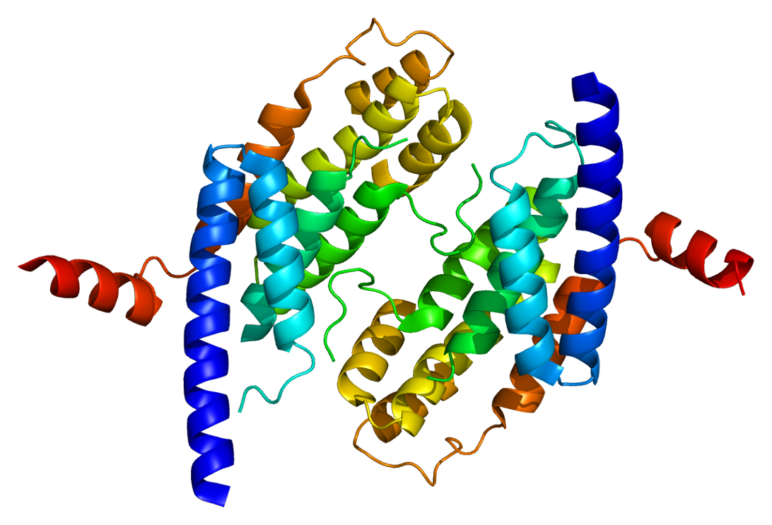
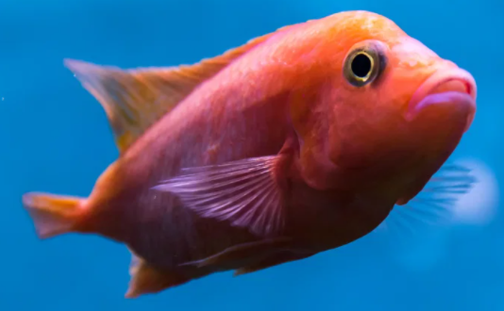
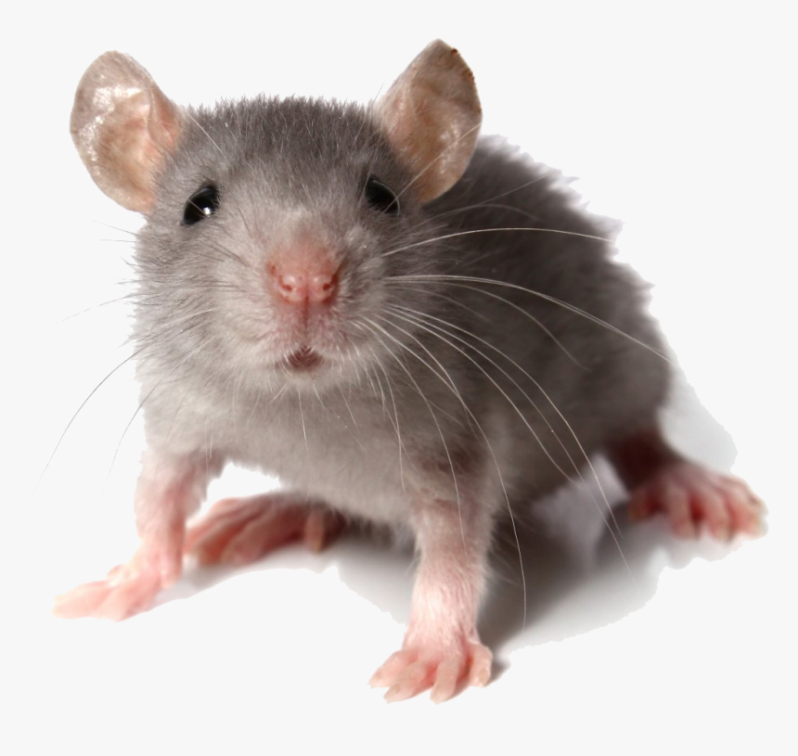
Genome
Scales of life
Protein

Slide 7
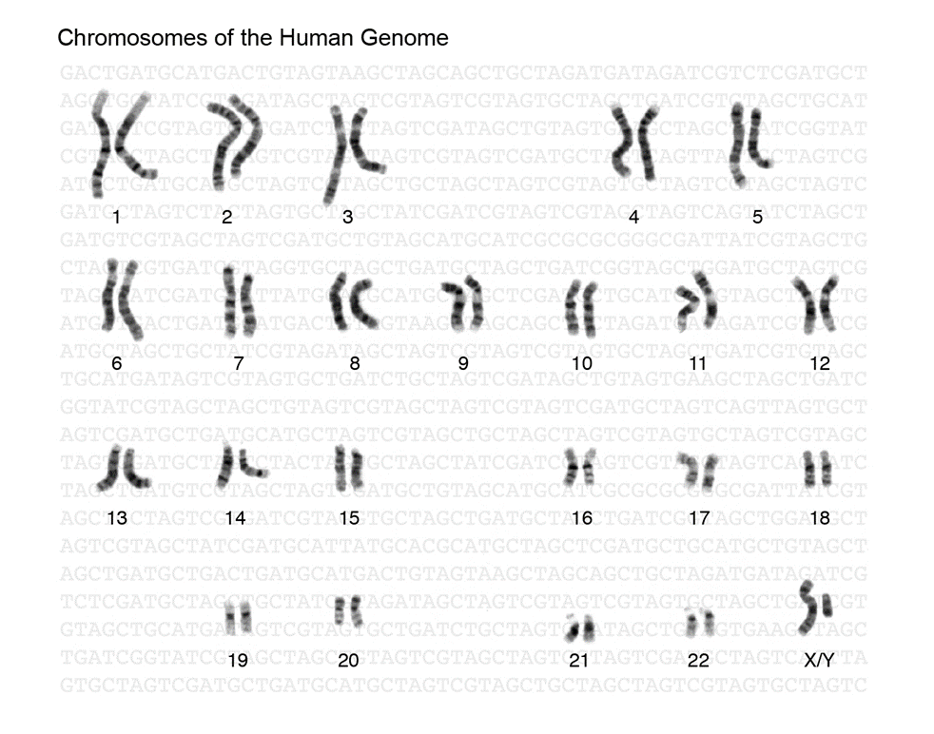
Molecular Biology Information - DNA
atggcaattaaaattggtatcaatggttttggtcgtatcggccgtatcgtattccgtgca
gcacaacaccgtgatgacattgaagttgtaggtattaacgacttaatcgacgttgaatac
atggcttatatgttgaaatatgattcaactcacggtcgtttcgacggcactgttgaagtg
aaagatggtaacttagtggttaatggtaaaactatccgtgtaactgcagaacgtgatcca
gcaaacttaaactggggtgcaatcggtgttgatatcgctgttgaagcgactggtttattc
ttaactgatgaaactgctcgtaaacatatcactgcaggcgcaaaaaaagttgtattaact
ggcccatctaaagatgcaacccctatgttcgttcgtggtgtaaacttcaacgcatacgca
ggtcaagatatcgtttctaacgcatcttgtacaacaaactgtttagctcctttagcacgt
gttgttcatgaaactttcggtatcaaagatggtttaatgaccactgttcacgcaacgact
gcaactcaaaaaactgtggatggtccatcagctaaagactggcgcggcggccgcggtgca
tcacaaaacatcattccatcttcaacaggtgcagcgaaagcagtaggtaaagtattacct
gcattaaacggtaaattaactggtatggctttccgtgttccaacgccaaacgtatctgtt
gttgatttaacagttaatcttgaaaaaccagcttcttatgatgcaatcaaacaagcaatc
aaagatgcagcggaaggtaaaacgttcaatggcgaattaaaaggcgtattaggttacact
gaagatgctgttgtttctactgacttcaacggttgtgctttaacttctgtatttgatgca
gacgctggtatcgcattaactgattctttcgttaaattggtatc . . .
. . . caaaaatagggttaatatgaatctcgatctccattttgttcatcgtattcaa
caacaagccaaaactcgtacaaatatgaccgcacttcgctataaagaacacggcttgtgg
cgagatatctcttggaaaaactttcaagagcaactcaatcaactttctcgagcattgctt
gctcacaatattgacgtacaagataaaatcgccatttttgcccataatatggaacgttgg
gttgttcatgaaactttcggtatcaaagatggtttaatgaccactgttcacgcaacgact
acaatcgttgacattgcgaccttacaaattcgagcaatcacagtgcctatttacgcaacc
aatacagcccagcaagcagaatttatcctaaatcacgccgatgtaaaaattctcttcgtc
ggcgatcaagagcaatacgatcaaacattggaaattgctcatcattgtccaaaattacaa
aaaattgtagcaatgaaatccaccattcaattacaacaagatcctctttcttgcacttgg
Raw DNA Sequence
Coding or Not?
Parse into genes?
4 bases: AGCT
~1 Kb in a gene, ~2 Mb in genome
~3 Gb Human

Slide 8
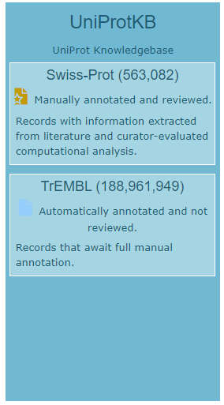
Molecular Biology Information: Protein Sequence
20 letter alphabet
ACDEFGHIKLMNPQRSTVWY but not BJOUXZ
Strings of ~300 aa in an average protein (in bacteria), ~200 aa in a domain
Millions of known protein sequences
d1dhfa_ LNCIVAVSQNMGIGKNGDLPWPPLRNEFRYFQRMTTTSSVEGKQ-NLVIMGKKTWFSI
d8dfr__ LNSIVAVCQNMGIGKDGNLPWPPLRNEYKYFQRMTSTSHVEGKQ-NAVIMGKKTWFSI
d4dfra_ ISLIAALAVDRVIGMENAMPWN-LPADLAWFKRNTL--------NKPVIMGRHTWESI
d3dfr__ TAFLWAQDRDGLIGKDGHLPWH-LPDDLHYFRAQTV--------GKIMVVGRRTYESF
d1dhfa_ LNCIVAVSQNMGIGKNGDLPWPPLRNEFRYFQRMTTTSSVEGKQ-NLVIMGKKTWFSI
d8dfr__ LNSIVAVCQNMGIGKDGNLPWPPLRNEYKYFQRMTSTSHVEGKQ-NAVIMGKKTWFSI
d4dfra_ ISLIAALAVDRVIGMENAMPW-NLPADLAWFKRNTLD--------KPVIMGRHTWESI
d3dfr__ TAFLWAQDRNGLIGKDGHLPW-HLPDDLHYFRAQTVG--------KIMVVGRRTYESF
https://www.uniprot.org/

Slide 9
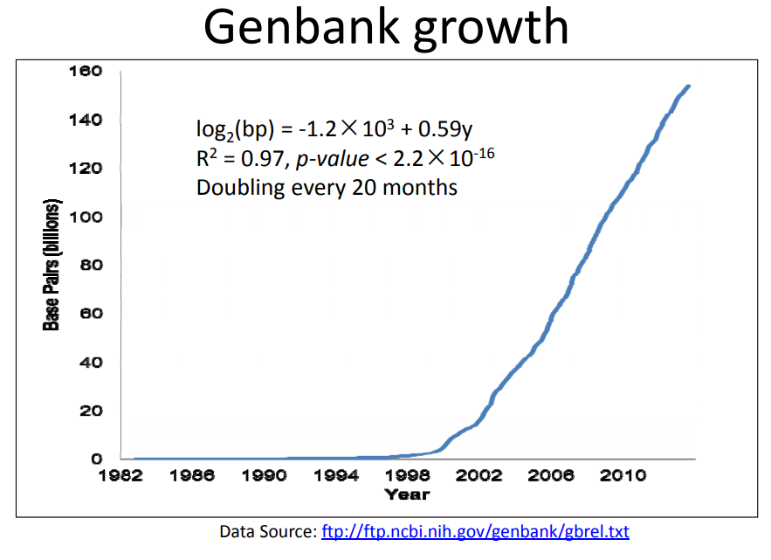
Bioinformatics and databases
High‐throughput data
huge amount
explosive growth
noisy
multi‐type
multi‐scale
Heterogeneous
Requirements for the methods
Data needs to be stored in efficient ontology‐based database systems
The huge amount of data requires efficient methods
Exponential growth requires scalable methods
The low signal‐to‐noise ratio requires accurate methods
Multiple types of data requires data integrative methods

Slide 10
Where to get data?
GenBank
http://www.ncbi.nlm.nih.gov/genbank/
The Cancer Genome Atlas
http://cancergenome.nih.gov/
Protein Databases
UniPort, IntAct and others at EBI: http://www.ebi.ac.uk/services/proteins
PDB: http://www.rcsb.org/
UCSC Genome Browser:
http://genome.ucsc.edu/
And many others

Slide 11
Current problems
Next generation sequencing
Gene regulation
Epigenetics and genetics of diseases, aging
SNPs, DNA methylation, histone modification
Comparison of whole genomes
Computational systems biology
Complexity, dynamics
the DREAM challenge
Structural bioinformatics, molecular dynamics simulations
Text mining
…. and many more

Slide 12
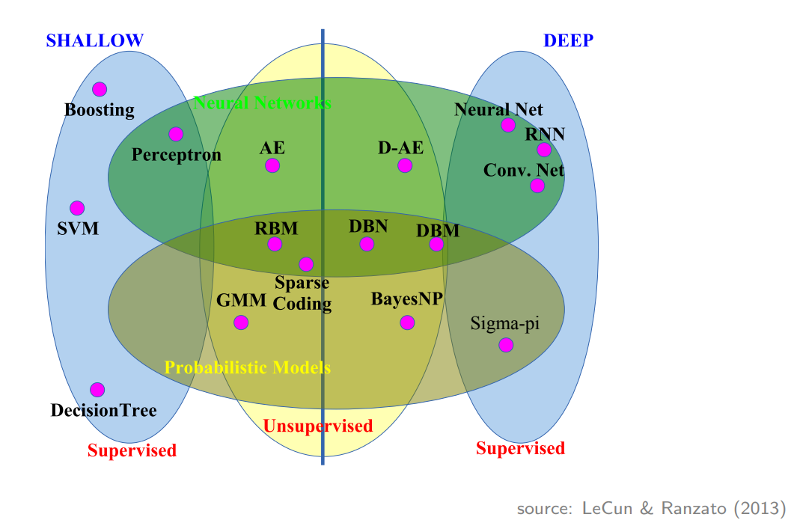
Machine learning
subfield of artificial intelligence “field of study that gives computers the ability to learn without being explicitly programmed” [A. Samuel, 1959]

Slide 13
Why AI/ML approaches to bioinformatics?
Solving complex problems with huge amounts of data but little theory.
[Peng et al., 2010] diverse AI applications “from knowledge-based reasoning to learning and discovering novel biomedical knowledge”
Generalization, reliability, and accuracy
[Leung et al., 2016] ML can “infer models that are capable of generalizing to new contexts (improving the longevity and quality of life for millions of individuals, both now and in years to come”)
[Coiera, 2003] AI approaches “actually have proven their reliability and accuracy on repeated occasions”
Predictive modeling under uncertainty
[Angermueller et al., 2016] ML can “drive predictive models without a need for strong assumptions about underlying mechanisms (which are frequently unknown or insufficiently defined)”

Slide 14
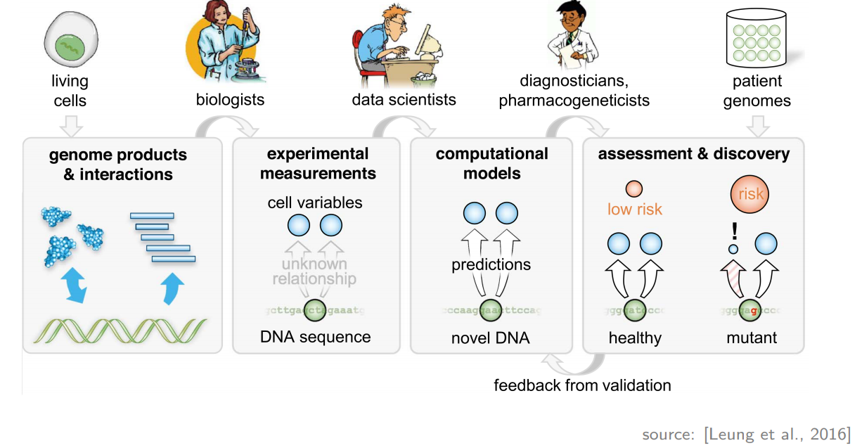
Why AI/ML approaches to bioinformatics?
high-throughput data modeling
[Leung et al., 2016] “ML plays a central role by turning high-throughput measurements into specialized or general-purpose predictive models”

Slide 15
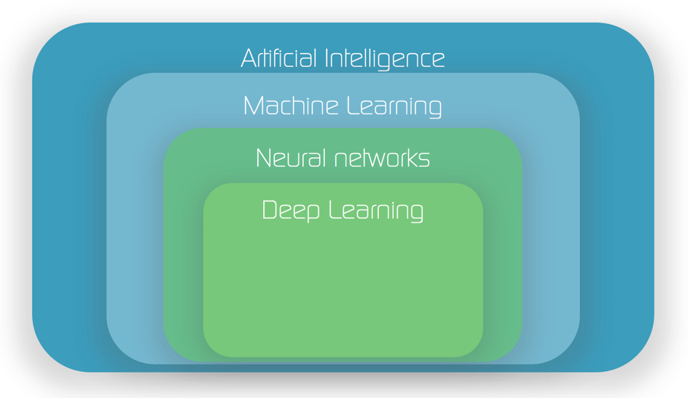
Deep Learning
“new” ML technique that has a long “history”
deep learning is driving the recent AI boom

Slide 16
Deep Learning
What exactly is deep learning ?
Why is it generally better than other methods on image, speech and certain other types of data such as biological data?
The short answer
‘Deep Learning’ means using a neural network with several layers of nodes between input and output.
The series of layers between input & output do feature identification and processing in a series of stages, just as our brains seem to.

Slide 17
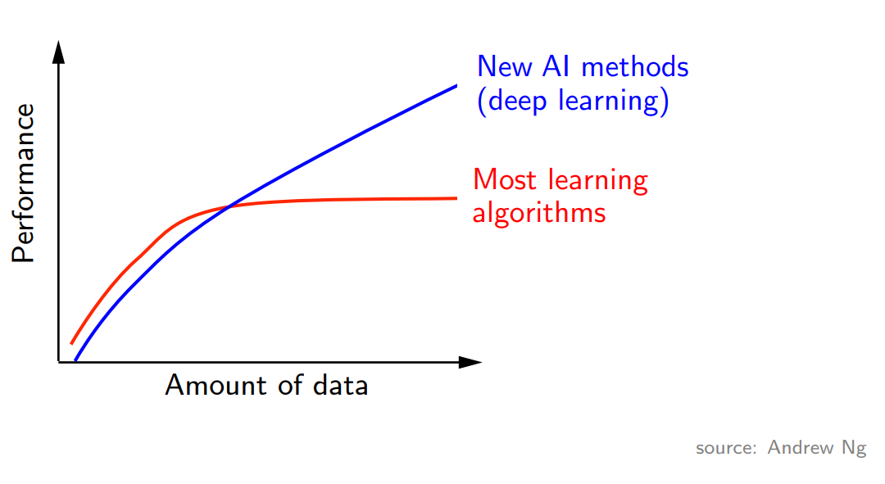
Deep Learning
Three key driving forces
1. big data
2. power of parallel/distributed computing
3. sophisticated algorithms

Slide 18
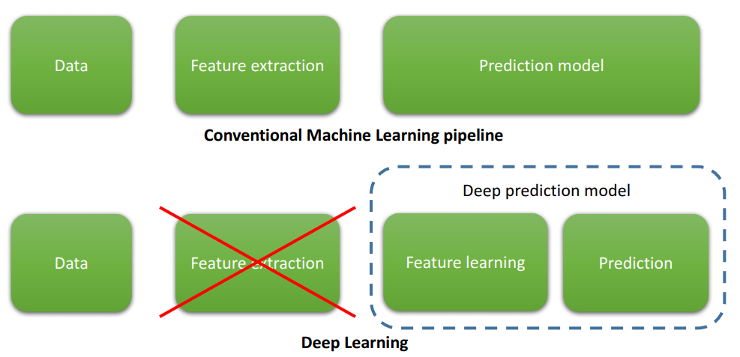
Deep Learning
traditional model of pattern recognition (since the late 50’s)
fixed/engineered features (or kernel) + trainable classifier
end-to-end learning/feature learning/deep learning
trainable features (or kernel) + trainable classifier

Slide 19
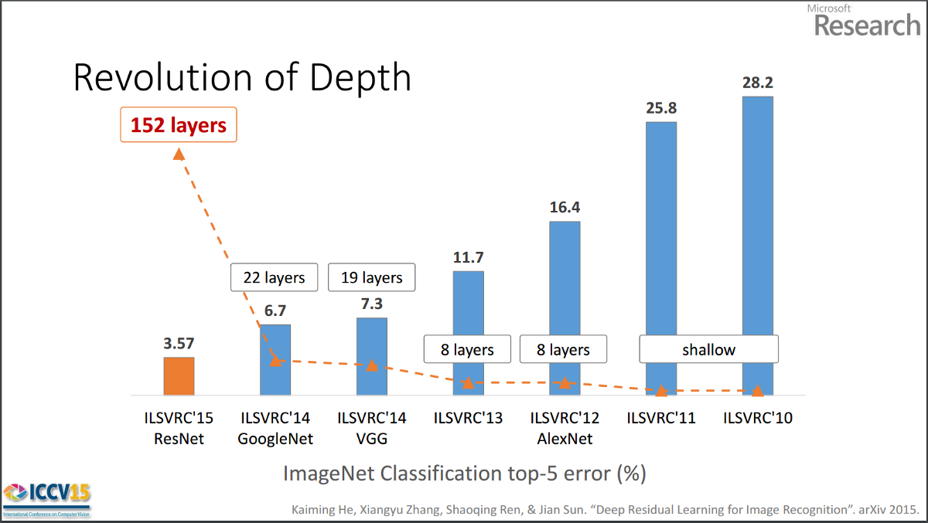
Deep Learning
Why do we need it? Image recognition

Slide 20
Deep Learning
Why do we need it? Speech recognition

Slide 21
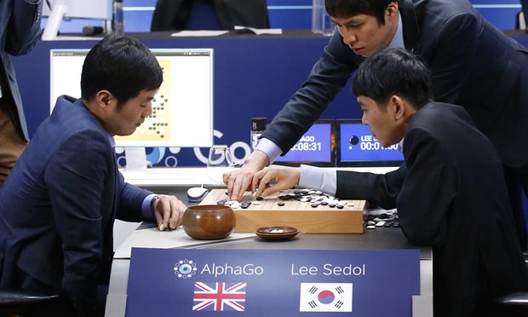
Deep Learning
Why do we need it? Strategies learning
DeepMind’s AlphaGo beats Lee Sedol 4-1 in Go !!

Slide 22
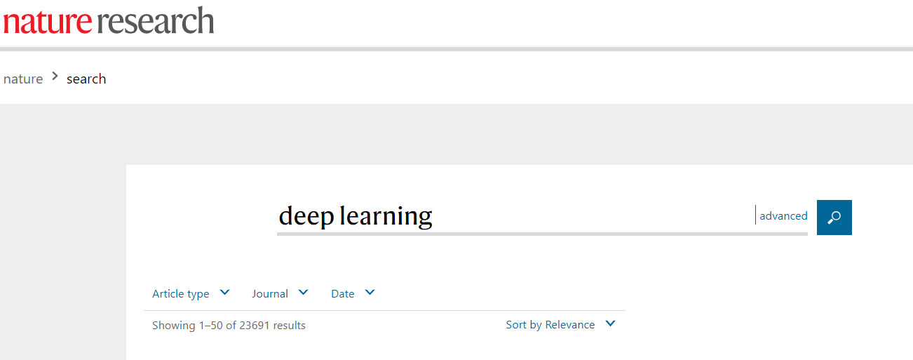
Deep Learning in biology

Slide 23
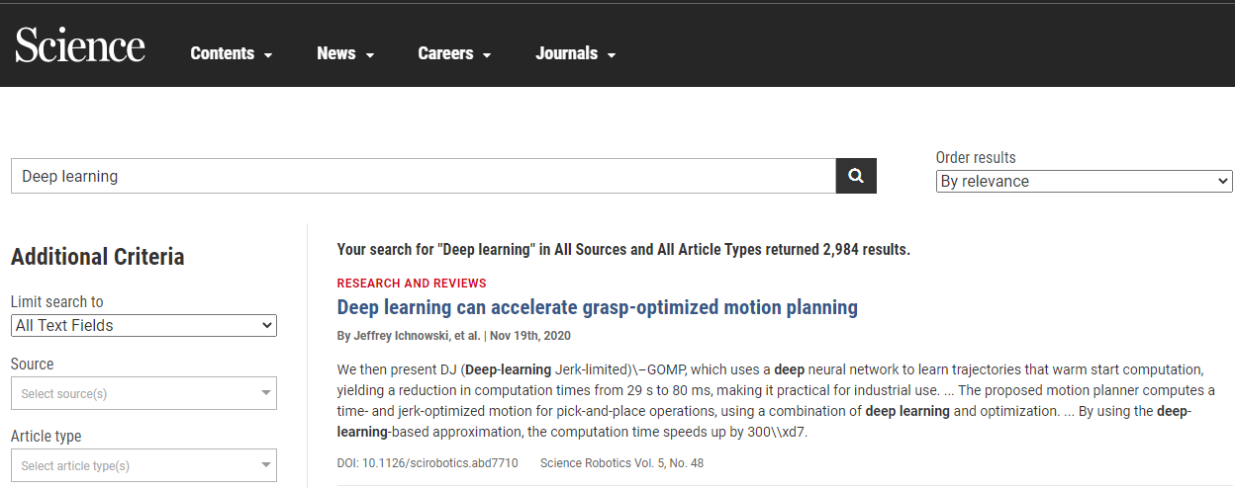
Deep Learning in biology

Slide 24
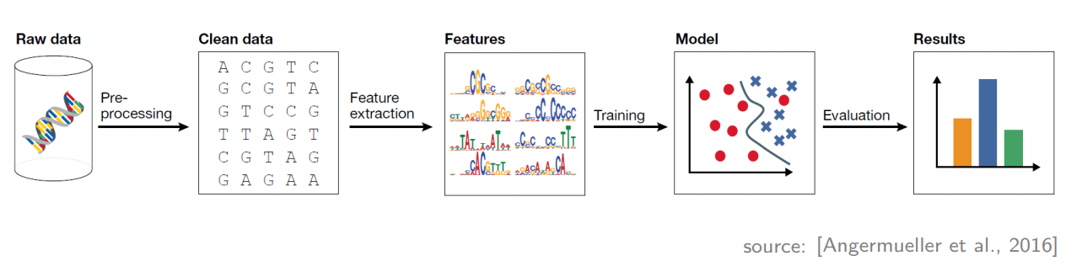
Classical machine learning workflow
preprocessing
feature engineering
model selection & learning
evaluation

Slide 25
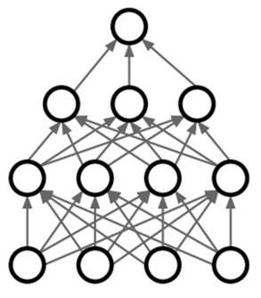
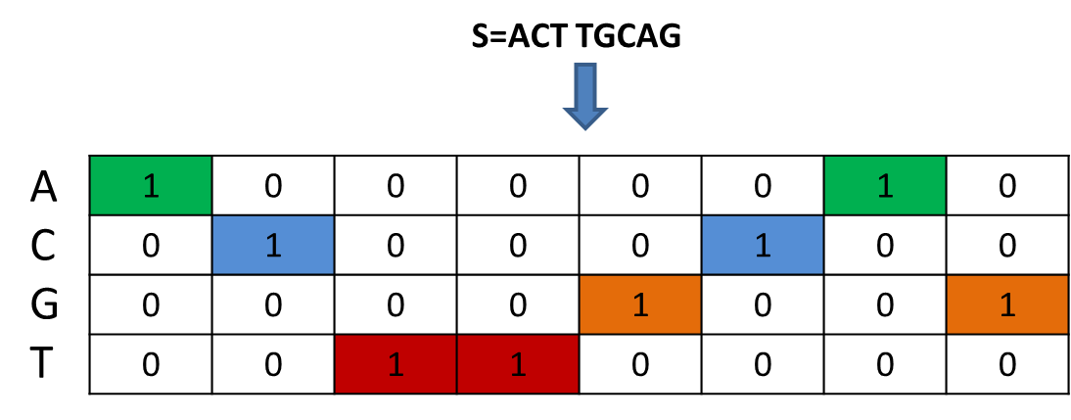
Deep learning workflow
Deep Learning model
CNN/RNN
Predictions

Slide 26
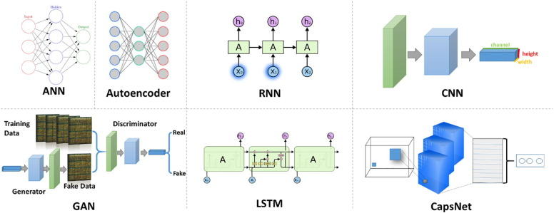
Deep learning
source Koumakis et al. 2020

Slide 27
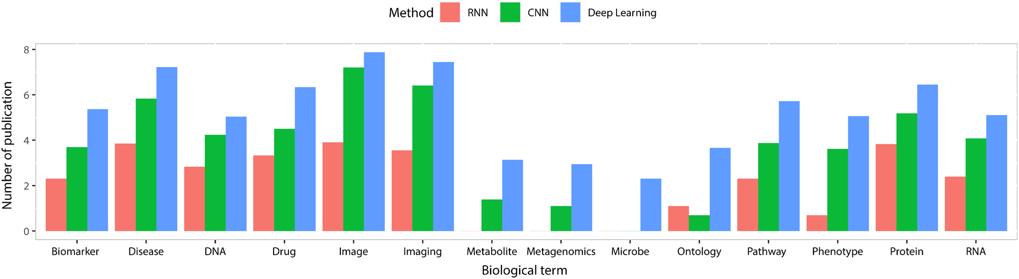
Deep learning
Number of publications (log-scale) for 14 biological topics. For each topic, the three bars show the number of publications mentioning the terms ‘RNN’, ‘CNN’, and ‘deep learning’, respectively.
Source Li et al. 2020

Slide 28
End of part 1

